Slide 1
Generic DSD Matrix
Adding SDMX generation functionality

Slide 2
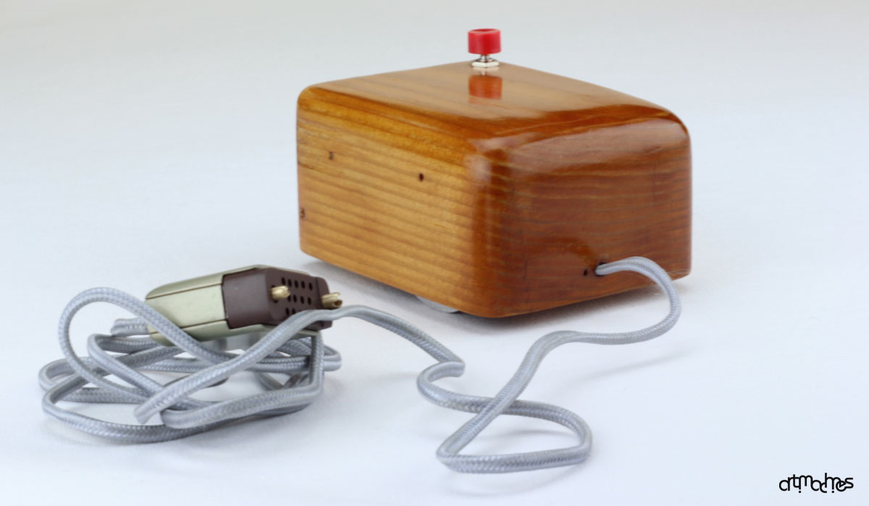
Design only tool currently

Slide 3
Part of SDMX guidelines
https://statswiki.unece.org/display/SDMXPM/DESIGN

Slide 4
Existing use of design tool
National Accounts
BoP
Labour
Education
SDGs
SEEA
R&D
…

Slide 5

Now creates SDMX from the design

Slide 6


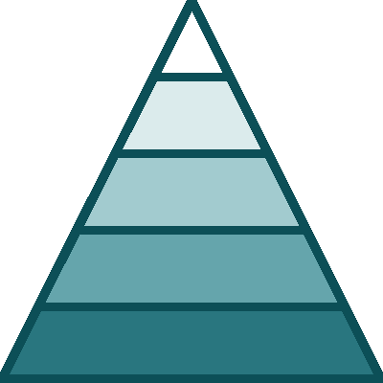
Could add…
Create categorisation
Synthetic Data files creation
Hierarchy in codelists

